Slide 1


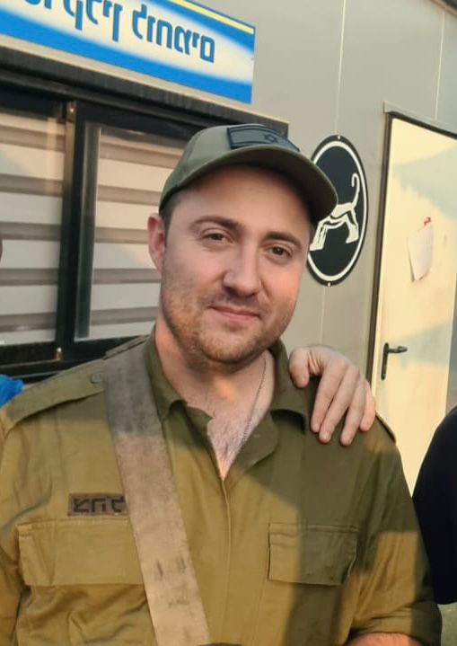
Course: Image Processing 31651
Assignment #31
Geometrical Transforms
Photo of the student | Shorten Name | ID (4 last digits)
 | shienfeld | 1950 | Student #1
 | pony | 2210 | Student #2
 | akimov | 7939 | Student #3
Photo of the student | Shorten Name | ID (4 last digits)
 | shienfeld | 1950 | Student #1
 | pony | 2210 | Student #2
 | akimov | 7939 | Student #3

Slide 2
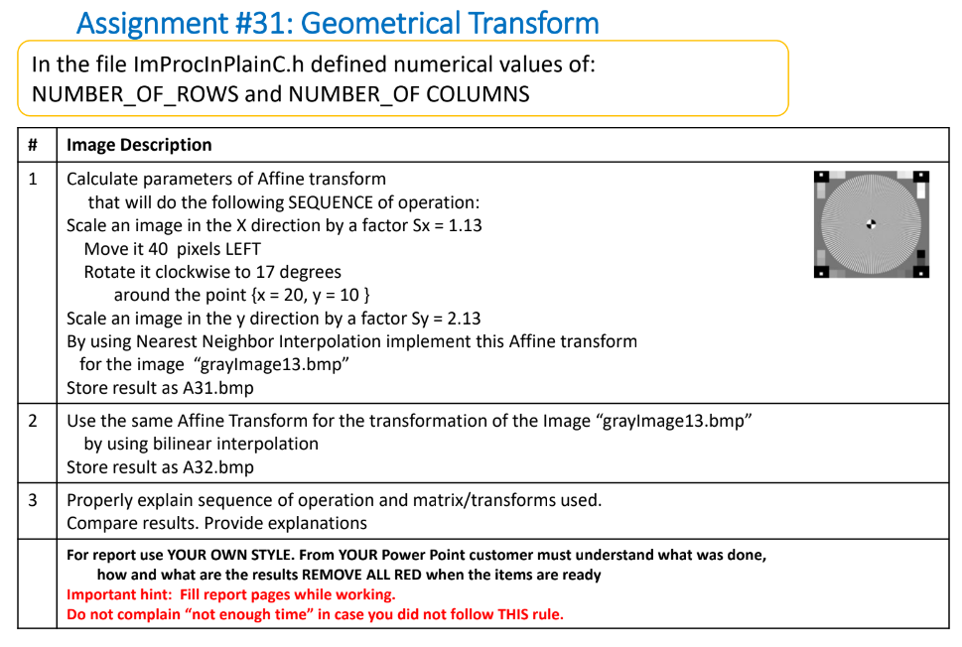

Slide 3
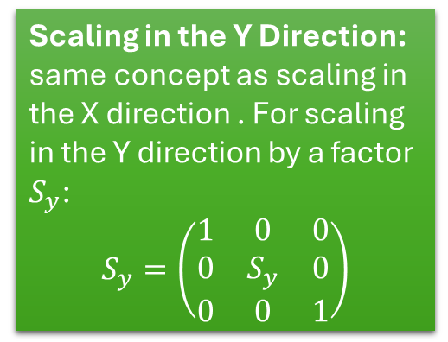
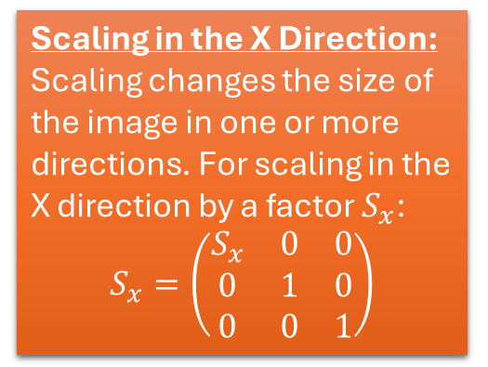
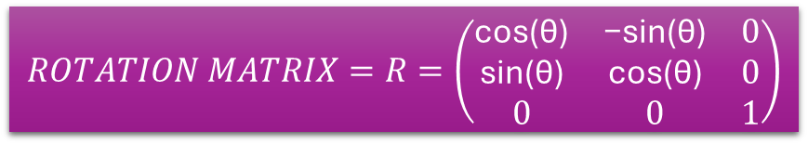
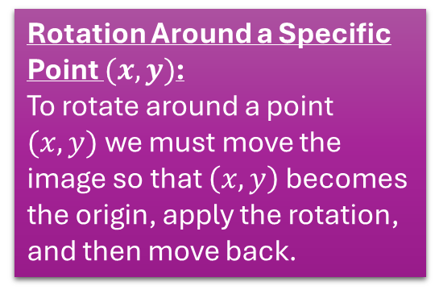
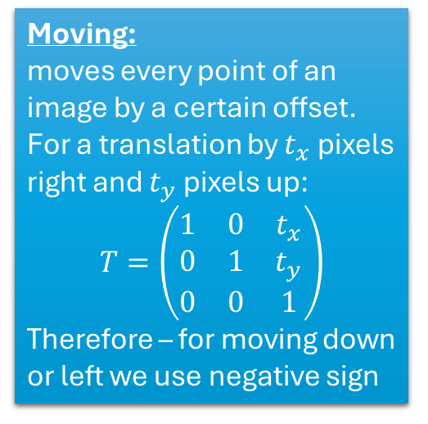
31.1 – mathematical background about affine transformations-part 1
We are going to use several affine transformations according to the demand of the task – all the transformations (operations) will be modeled using matrix operations :
Scaling in the X Direction:
Scaling changes the size of the image in one or more directions. For scaling in the X direction by a factor $S_{x}$:
$$S_{x}=\left(\begin{matrix}S_{x} & 0 & 0 \\ 0 & 1 & 0 \\ 0 & 0 & 1\end{matrix}\right)$$
Scaling in the Y Direction:
same concept as scaling in the X direction . For scaling in the Y direction by a factor $S_{y}$:
$$S_{y}=\left(\begin{matrix}1 & 0 & 0 \\ 0 & S_{y} & 0 \\ 0 & 0 & 1\end{matrix}\right)$$
Rotation Around a Specific Point $(x,y)$:
To rotate around a point $(x,y)$we must move the image so that $\left(x,y\right)$ becomes the origin, apply the rotation, and then move back.
Moving:
moves every point of an image by a certain offset.
For a translation by $t_{x}$pixels right and $t_{y}$ pixels up:
$$T=\left(\begin{matrix}1 & 0 & t_{x} \\ 0 & 1 & t_{y} \\ 0 & 0 & 1\end{matrix}\right)$$
Therefore – for moving down or left we use negative sign
$$ROTATION MATRIX=R=\left(\begin{matrix}\text{cos}\text{(}\text{θ}\text{)} & \text{−}\text{sin}\text{(}\text{θ}\text{)} & 0 \\ \text{sin}\text{(}\text{θ}\text{)} & \text{cos}\text{(}\text{θ}\text{)} & 0 \\ 0 & 0 & 1\end{matrix}\right)$$

Slide 4
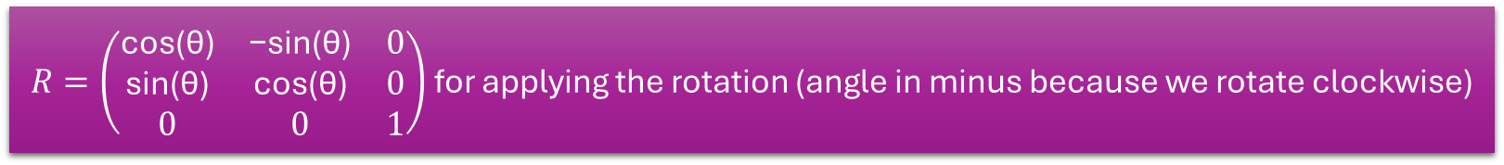
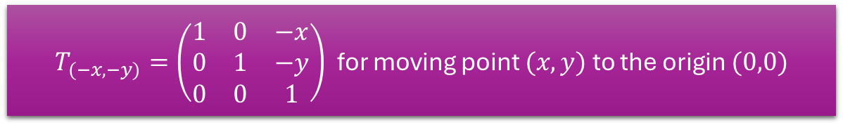
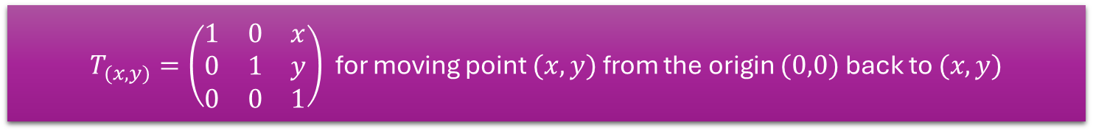
31.1 – mathematical background about affine transformations-part 2
The total matrix for the operation of “Rotate it clockwise to 17 degrees
around the point {x = 20, y = 10 } ” will be comprised of the 3 matrix (=3 steps)
$T_{(−x,−y)}=\left(\begin{matrix}1 & 0 & −x \\ 0 & 1 & −y \\ 0 & 0 & 1\end{matrix}\right)$for moving point $(x,y)$ to the origin $(0,0)$
$R=\left(\begin{matrix}\text{cos}\text{(}\text{θ}\text{)} & \text{−}\text{sin}\text{(}\text{θ}\text{)} & 0 \\ \text{sin}\text{(}\text{θ}\text{)} & \text{cos}\text{(}\text{θ}\text{)} & 0 \\ 0 & 0 & 1\end{matrix}\right)$ for applying the rotation (angle in minus because we rotate clockwise)
$T_{(x,y)}=\left(\begin{matrix}1 & 0 & x \\ 0 & 1 & y \\ 0 & 0 & 1\end{matrix}\right)$for moving point $(x,y)$ from the origin $(0,0)$ back to $(x,y)$
The total matrix operation for the rotation is : $R_{around (x,y)}=T_{(x,y)}∗R∗T_{(−x,−y)}$

Slide 5

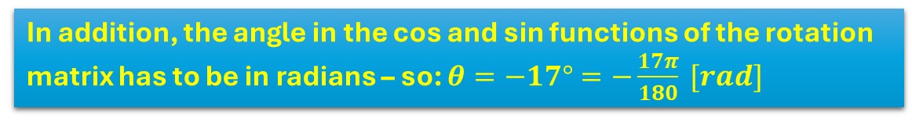
31.1 – mathematical background about affine transformations-part 3
The total matrix for the operation of will be comprised of the 6 matrix (=6 steps):
$$A=S_{y}∗T_{\left(x,y\right)}∗R∗T_{\left(−x,−y\right)}∗T∗S_{x}$$
The task is : “Scale an image in the X direction by a factor Sx = 1.13 , Move it 40 pixels LEFT , Rotate it clockwise to 17 degrees around the point {x = 20, y = 10 } ,
Scale an image in the y direction by a factor Sy = 2.13.
The total matrix for the operation with final numbers will be :
$$A=S_{2.13}∗T_{\left(20,10\right)}∗R∗T_{\left(−20,−10\right)}∗T∗S_{1.13}$$
In addition, the angle in the cos and sin functions of the rotation matrix has to be in radians – so: $θ=−17°=−\frac{17π}{180} [rad]$

Slide 6
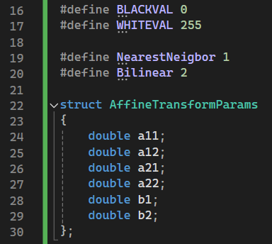
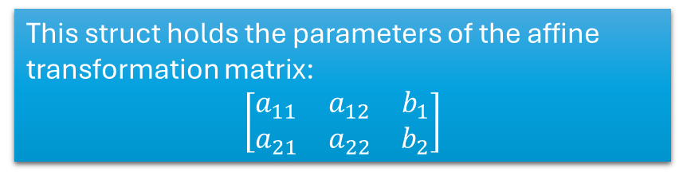
NearestNeigbor and Bilinear: These are the two methods we are going to use.
AffineTransformParams holds six coefficients (matrices in fact) that control how the image is transformed (stretched, moved, and rotated).
a11, a12, a21, a22 - control how the image is stretched or rotated.
b1, b2 control how the image is moved (up, down, left, or right).
This struct holds the parameters of the affine transformation matrix:
$$\left[\begin{matrix}a_{11} & a_{12} & b_{1} \\ a_{21} & a_{22} & b_{2}\end{matrix}\right]$$

Slide 7
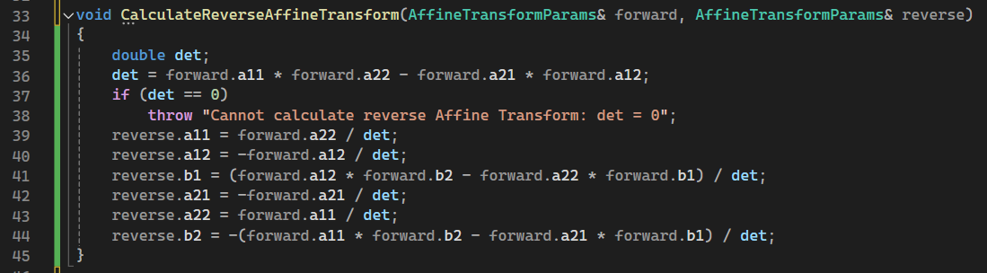
This function calculates the inverse of the affine transformation. If you think of the affine transformation as an operation that maps coordinates from the original image to the transformed image, this function reverses that operation.
note : In matrix operations, the determinant is used to determine if the matrix is invertible. If det is zero, the matrix is singular, meaning it can’t be inverted (hence the exception).

Slide 8
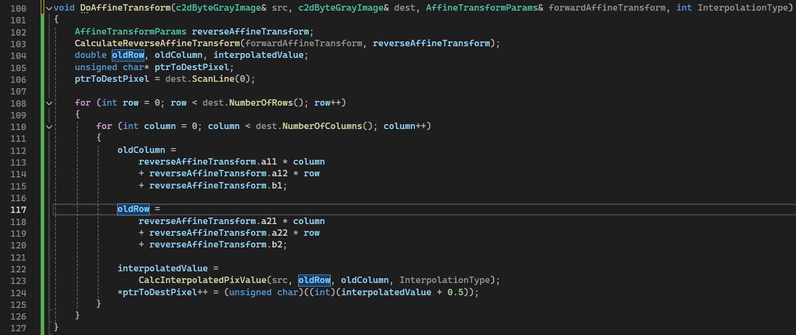
That function calculates where each pixel in the transformed image comes from in the original image.
The ptrToDestPixel++ is moving through the destination image memory to place each transformed pixel value.

Slide 9
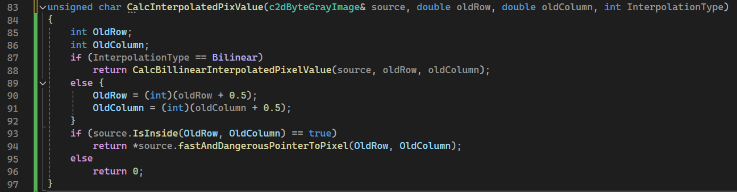

Slide 10
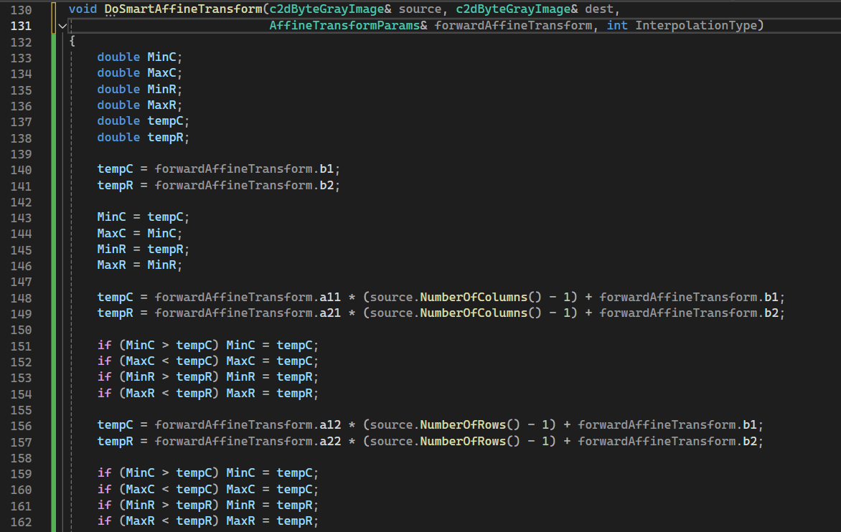
These variables are used to track the minimum and maximum values of the transformed coordinates. This is essential because after applying the affine transformation, the image might no longer fit within its original dimensions.

Slide 11
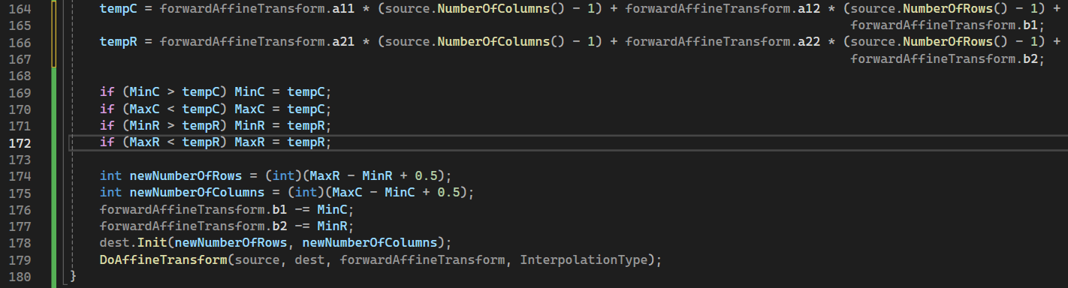
Finally, the DoAffineTransform function is called to apply the actual affine transformation to the source image, filling in the destination image with the appropriately transformed pixels.
This function adjusts the size of the destination image based on the transformation and then applies the affine transformation.

Slide 12
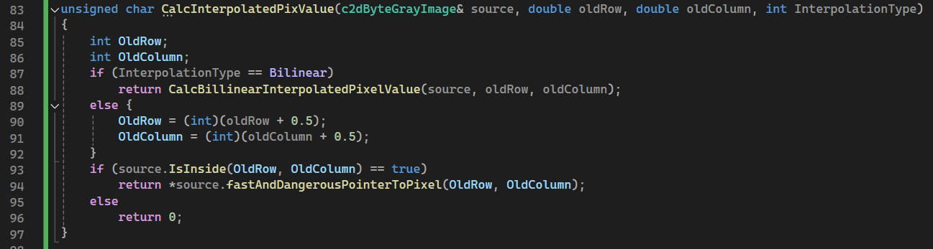

Slide 13
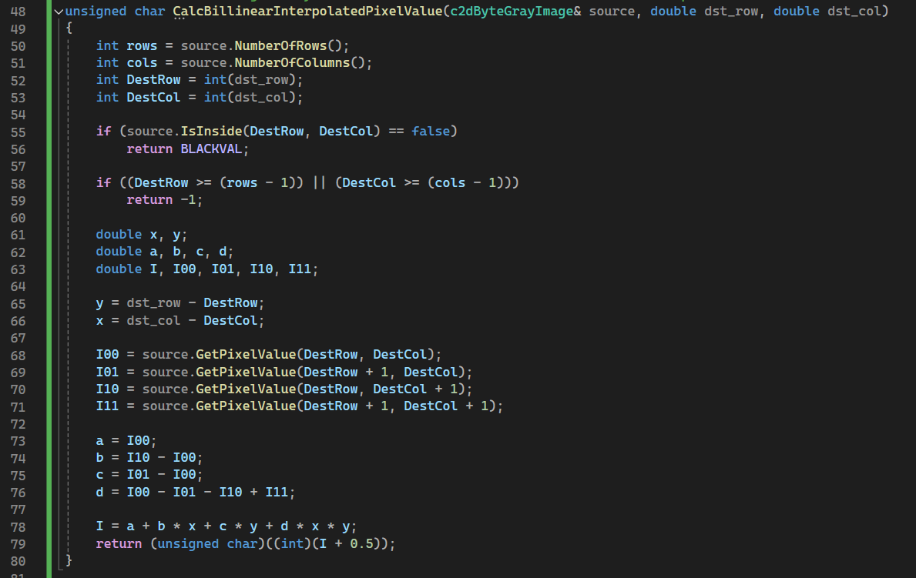

Slide 14
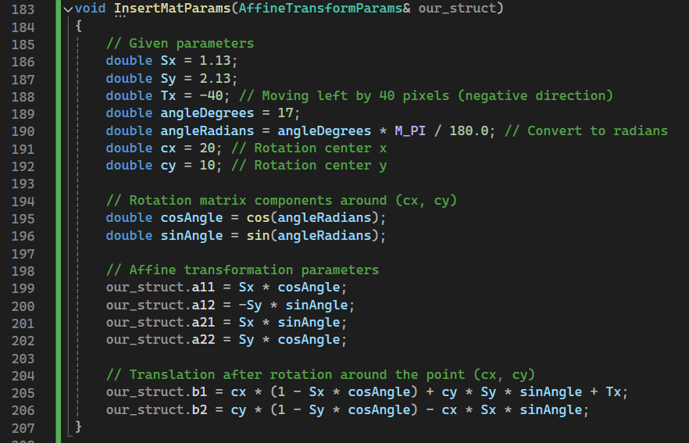
These parameters scale the image. Sx stretches or shrinks the image horizontally, while Sy does the same vertically.
The image is moved 40 pixels to the left
The image is rotated by 17 degrees around a point (20, 10). This is calculated using trigonometric functions

Slide 15
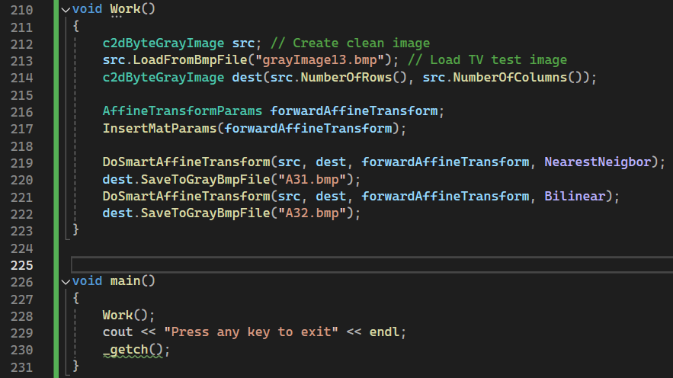
31.7 – the “main” function
The image grayImage13.bmp is loaded into the src object, which represents the source image.
The dest object is prepared to hold the transformed image.
The affine transformation is applied twice, once using Nearest Neighbor interpolation (result saved as A31.bmp) and once using Bilinear interpolation (result saved as A32.bmp).

Slide 16
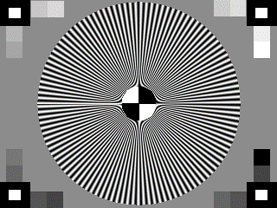
31.8 - Resulted photographs – “A31.bmp”,”A32.bmp”
“grayImage13.bmp” - Source image
“A31.bmp” - Created by using
nearest neighbor interpolation
“A32.bmp” - Created by using
bilinear interpolation

Slide 17

31.9 –profilers of Resulted photographs – “A31.bmp”,”A32.bmp”
A31.bmp
A32.bmp

Slide 18
31.10 –deeper look at the results-“A31.bmp” vs ”A32.bmp”
A31.bmp
A32.bmp
1
1
3
3
4
4
2
2
The black straight lines are much more disrupted in the A31.bmp.
The small white rectangles in the corners – their outline are much more disrupted in the A31.bmp.
The area from the right hand side of the center is much more disrupted – a lot of added noise in A31.bmp.
The lines that assemble the black and white circle in the center are much more disrupted in A31.bmp.
Therefore, our opinion is that the bilinear interpolation is a way more successful method than the nearest neighbor interpolation.

Slide 19
31.8 – What did we learn ?
1) To use two algorithms that can create the same result in different ways: Bilinear interpolation and nearest neighbor.
2) To acknowledge what is interpolation and how it use it.
3) How to use Nearest Neighbor Interpolation algorithm to rotate the image.
4) How to use Bilinear Interpolation algorithm to rotate the image.
5) To apply sequence of operations on an image (move it, scale it, rotate it around the point).

